Slide 1


LECTURE 8: Peripheral ADC
EMBEDDED SYSTEM COURSE

Slide 2
Learning Goals
Understanding basis concepts about A/D converter.
Understanding on how to configure the ADC module in KL46.
Understanding on how to create a simple project for ADC module.

Slide 3
Table of contents
Introduction to A/D converter.
Overview on KL46 ADC modules

Slide 4
Table of contents
Introduction to A/D converter.
Overview on KL46 ADC modules
Periodic Interrupt Timer (PIT) Module

Slide 5
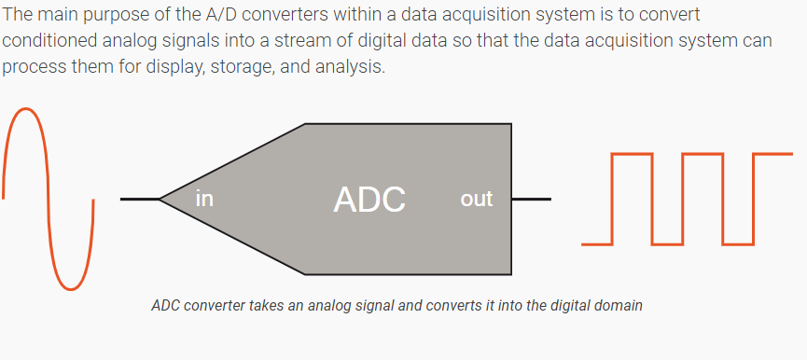
What is A/D converter?

Slide 6
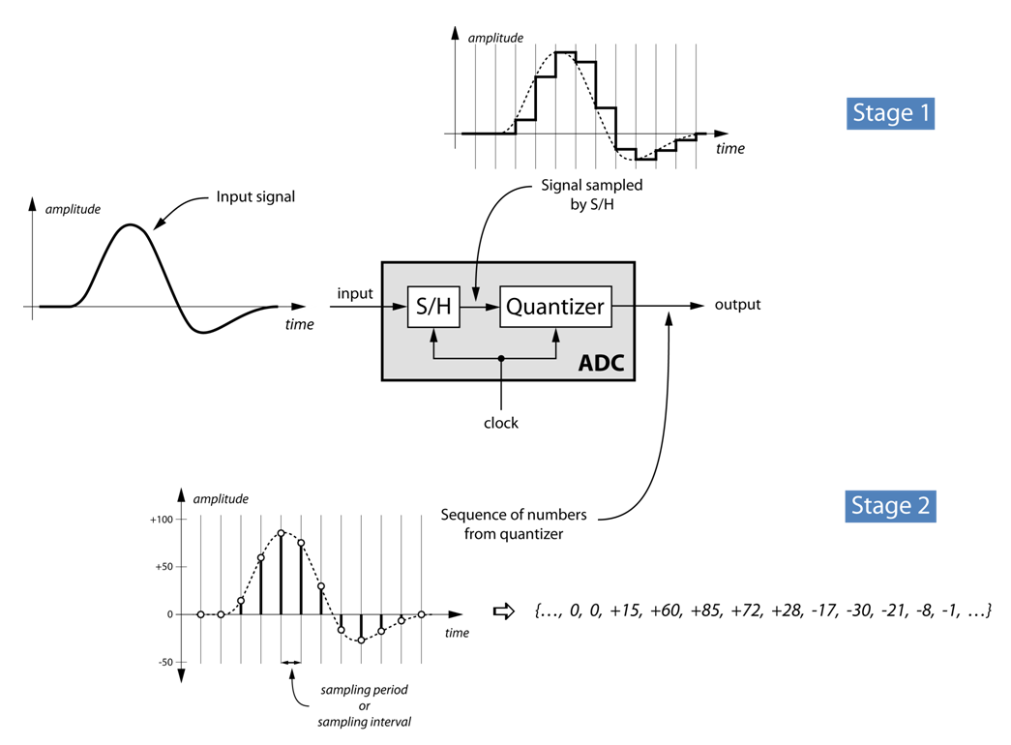
What Do A/D Converters Do?

Slide 7
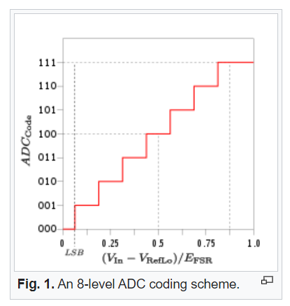
What is resolution?
The resolution of the converter indicates the number of different, ie discrete, values it can produce over the allowed range of analog input values.
(wiki)

Slide 8
What is the Sampling Rate?
An analog signal is continuous in time and it is necessary to convert this to a flow of digital values. It is therefore required to define the rate at which new digital values are sampled from the analog signal. The rate of new values is called the sampling rate or sampling frequency of the converter.
The Nyquist–Shannon:
(wiki)

Slide 9
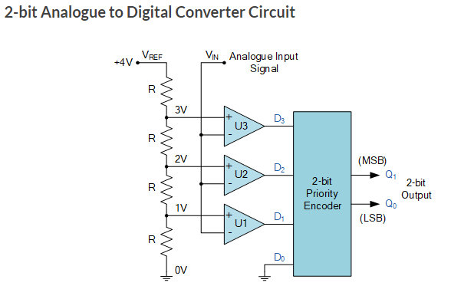
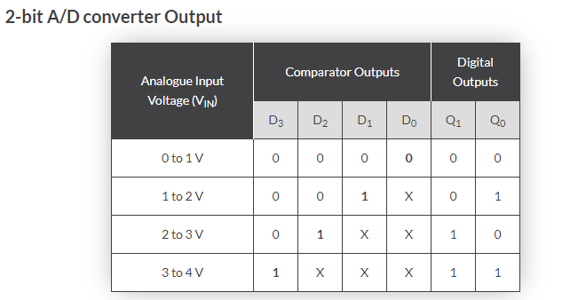
A/D converter architecture
Flash ADC
Sucessive-approximation ADC
Ramp-compare ADC
Delta-encoded ADC or counter-ramp
…

Slide 10
A/D converter architecture
Flash ADC

Slide 11
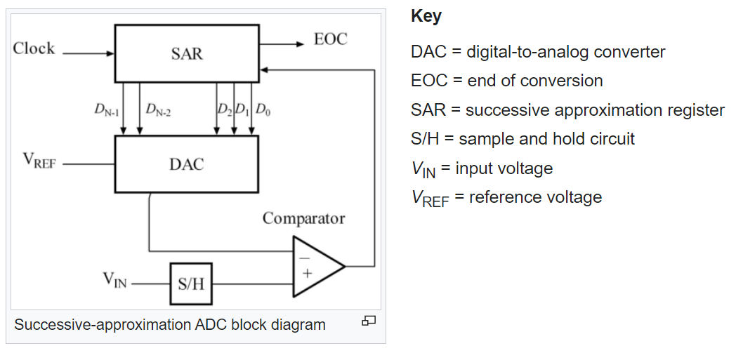
A/D converter architecture
Sucessive-approximation ADC

Slide 12
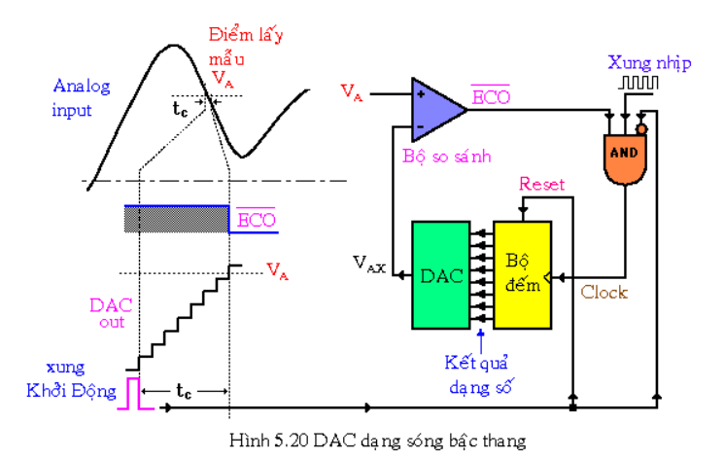
A/D converter architecture
Ramp-compare ADC

Slide 13
Table of contents
Introduction to A/D converter.
Overview on KL46 ADC modules
Periodic Interrupt Timer (PIT) Module

Slide 14
MKL46Z ADC features
• Linear successive approximation algorithm with up to 16-bit resolution
• Up to four pairs of differential and 24 single-ended external analog inputs
• Output modes:
differential 16-bit, 13-bit, 11-bit, and 9-bit modes
single-ended 16-bit, 12-bit, 10-bit, and 8-bit modes
• Output format in 2's complement 16-bit sign extended for differential modes
• Single or continuous conversion, that is, automatic return to idle after singlen conversion
• Conversion complete/hardware average complete flag and interrupt
• Input clock selectable from up to four sources
• Selectable hardware conversion trigger with hardware channel select
• Automatic compare with interrupt for less-than, greater-than or equal-to, within range, or out-of-range, programmable value

Slide 15
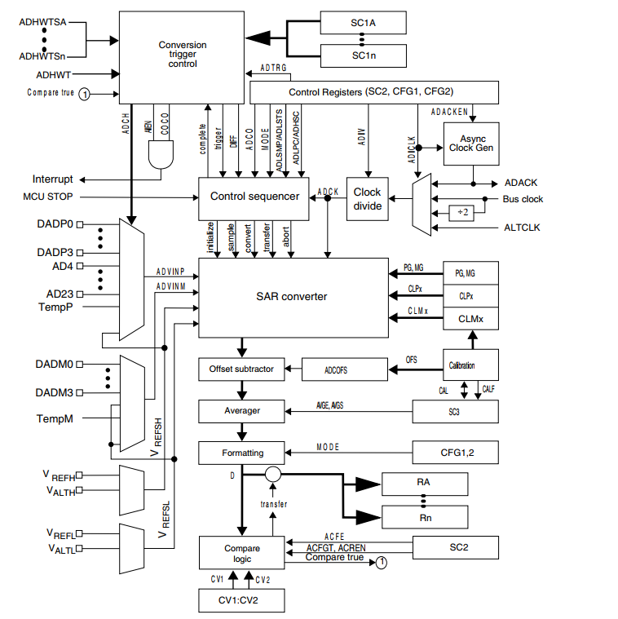
MKL46Z ADC Block Diagram

Slide 16
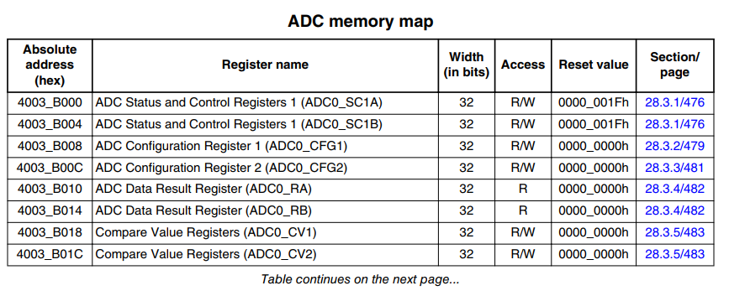
MKL46Z ADC Register

Slide 17
How to program for adc?
Notes:
49999

Slide 18

Question & Answer
Thanks for your attention !

Slide 19
Copyright
This course including Lecture Presentations, Quiz, Mock Project, Syllabus, Assignments, Answers are copyright by FPT Software Corporation.
This course also uses some information from external sources and non-confidential training document from Freescale, those materials comply with the original source licenses.

